Slide 1

The Data Ecosystem: Comprehensive Introduction
Exploring the Components of Data Ecosystem
Notes:
The data ecosystem is a complex and dynamic system that is critical to decision-making and business operations in the digital age. In this course, we will explore the various components of the data ecosystem, including data sources, databases, and analytics tools.

Slide 2
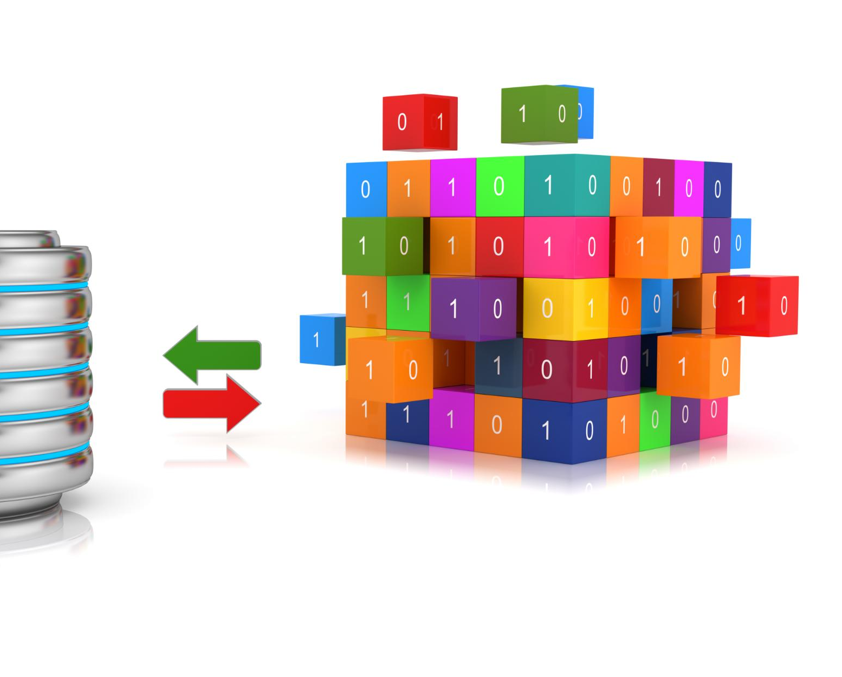
Course Contents
Introduction to the Data Ecosystem
Sources of Data
Databases
Notes:
In this course, we will start by providing an overview of the data ecosystem, its importance in decision-making and business operations, and its key components. Then, we will delve into the various sources of data, including internal and external sources, real-time and batch data, and transactional systems, IoT and sensor data, social media platforms, surveys and polls, and third-party datasets. Finally, we will explore databases, including their different types, management systems, and operations.

Slide 3
Introduction to the Data Ecosystem
Notes:
The data ecosystem is a complex and dynamic system that is critical to decision-making and business operations in the digital age. In this section, we will provide an overview of the data ecosystem, its importance in decision-making and business operations, key components, and evolution over time.

Slide 4

Overview of the Data Ecosystem
Data Sources
  Data sources are the origin of the data and can be internal or external to the organization. Understanding data sources is essential for assessing data quality and reliability.
Databases
  Databases are the foundation of the data ecosystem and provide a means to store, manage, and organize data. Understanding databases is crucial for ensuring data integrity and security.
Analytics Tools
  Analytics tools are critical for extracting insights and value from data. Understanding analytics tools is essential for identifying patterns and trends, and making informed decisions.
Notes:
The data ecosystem is a complex network of people, processes, and technologies that interact to produce, manage, and analyze data. It includes data sources, databases, analytics tools, and human operators. Understanding the data ecosystem is critical to making informed decisions and achieving business success.

Slide 5
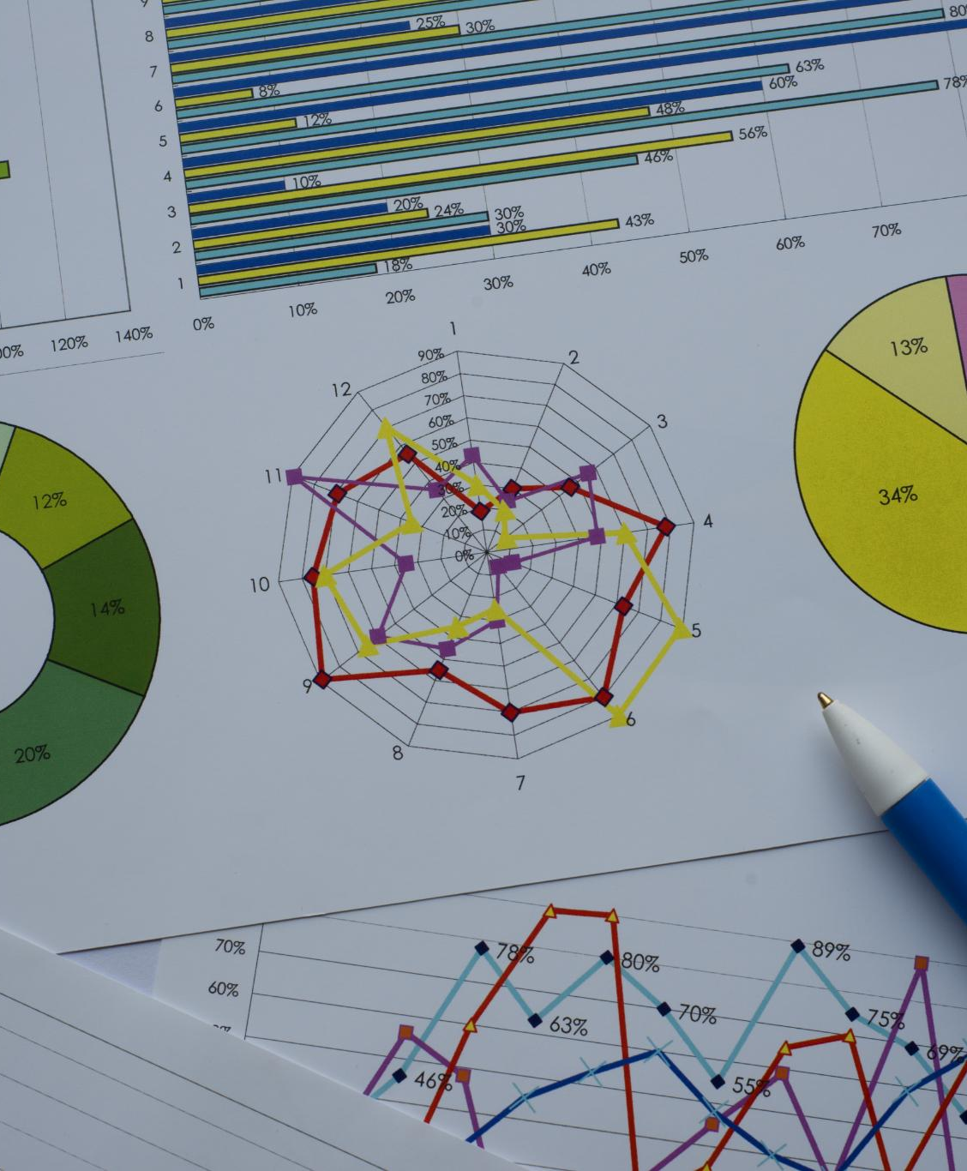
Importance of Data in Decision-Making and Business Operations
Customer Behavior Insights
  Data provides valuable insights into customer behavior and preferences, allowing businesses to tailor their products and services to meet the needs of their target audience.
Market Trend Analysis
  Data helps businesses stay on top of market trends and identify emerging opportunities, enabling them to adapt quickly to changing market conditions.
Operational Efficiency Improvement
  Data can help businesses identify areas of inefficiency and waste in their operations, allowing them to streamline processes and reduce costs.
Notes:
Data is the lifeblood of modern business operations. It provides valuable insights into customer behavior, market trends, and operational efficiency. With the right data, businesses can make informed decisions that drive growth and profitability.

Slide 6
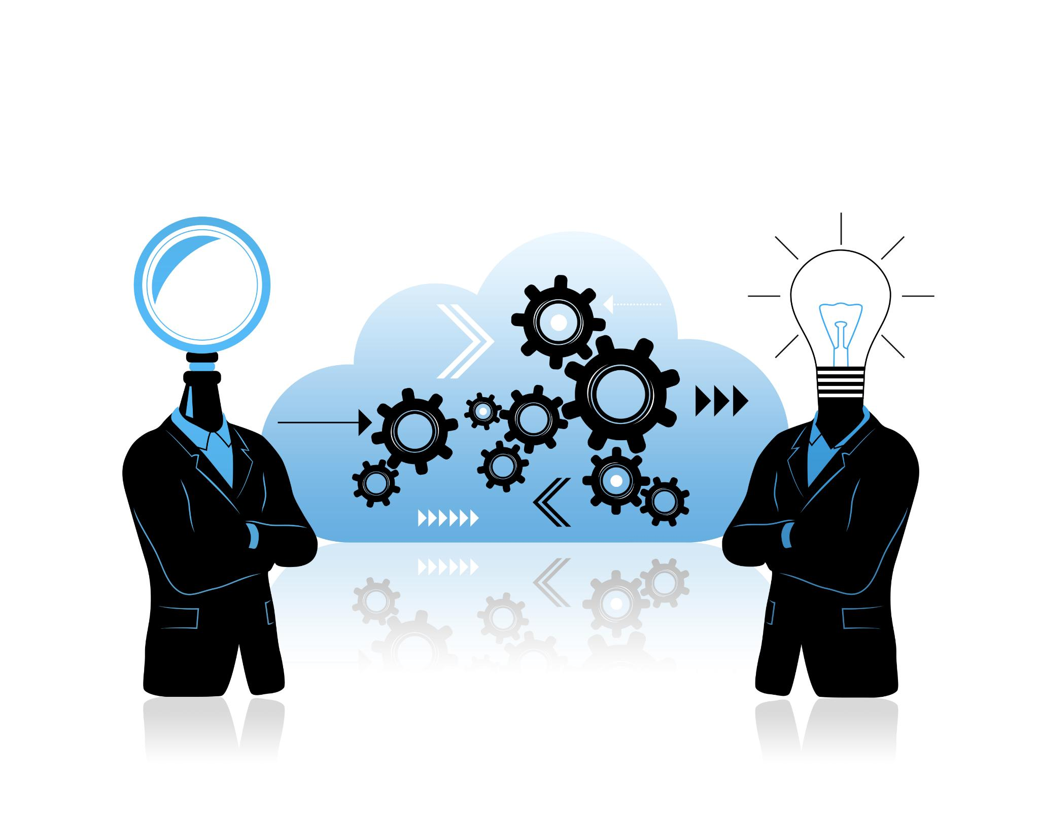
Key Components of the Data Ecosystem
Data Sources
  Data sources are the origin of raw data, such as sensors, social media, or public records, that are used to produce, manage, and analyze data.
Databases
  Databases are a structured collection of data that are organized, managed, and accessed by computers. They enable efficient data storage, retrieval, and data management.
Analytics Tools
  Analytics tools are software applications that enable data exploration, visualization, and analysis, such as business intelligence, machine learning, or data mining tools.
Human Operators
  Human operators are individuals responsible for managing, developing, and analyzing data in the data ecosystem.
Notes:
The data ecosystem comprises several key components, including data sources, databases, analytics tools, and human operators. Each component plays a crucial role in producing, managing, and analyzing data.

Slide 7

Evolution of Data Ecosystems
Batch Processing
  Batch processing was the earliest form of data processing, where data was collected and processed in batches at a later time. It was the primary method used for data processing until the arrival of real-time processing.
Real-Time Processing
  Real-time processing refers to the ability to process data immediately as it becomes available. This has become more common with the advent of new technologies like the internet and the cloud.
Big Data
  The term Big Data refers to the large and complex sets of data that are difficult to process using traditional data processing methods. It has become increasingly popular with the advent of the internet and is used in a variety of industries to gain insights and drive decision-making.
Notes:
The data ecosystem has evolved significantly over the last few decades, driven by advances in technology and changes in business needs. Understanding this evolution is critical to staying current with the latest trends and practices in the field.

Slide 8
Sources of Data
Notes:
Data comes from a variety of sources, both internal and external to the organization. In this section, we will explore the different types of data sources, common data sources, and data capture methods.

Slide 9

Types of Data Sources
Internal Data Sources
  Internal data sources are data that are collected from within an organization. Examples include financial reports, sales reports, and customer data. Internal data sources are typically easier to access and analyze, but may not provide a complete picture of the market or industry.
External Data Sources
  External data sources are data that are collected from outside an organization. Examples include market research reports, social media data, and government data. External data sources may provide a more complete picture of the market or industry, but may be more difficult to access and analyze.
Real-time Data
  Real-time data are data that are collected and analyzed in real-time. Examples include website traffic, social media interactions, and sensor data. Real-time data can be used to make quick decisions and respond to events as they happen.
Batch Data
  Batch data are data that are collected and analyzed in batches or sets. Examples include financial data, sales data, and customer data. Batch data can be used to analyze trends and patterns over time.
Notes:
Data sources can be categorized based on several factors, including whether they are internal or external, public or private, and real-time or batch data. Each type of data source has its own unique characteristics and challenges.

Slide 10
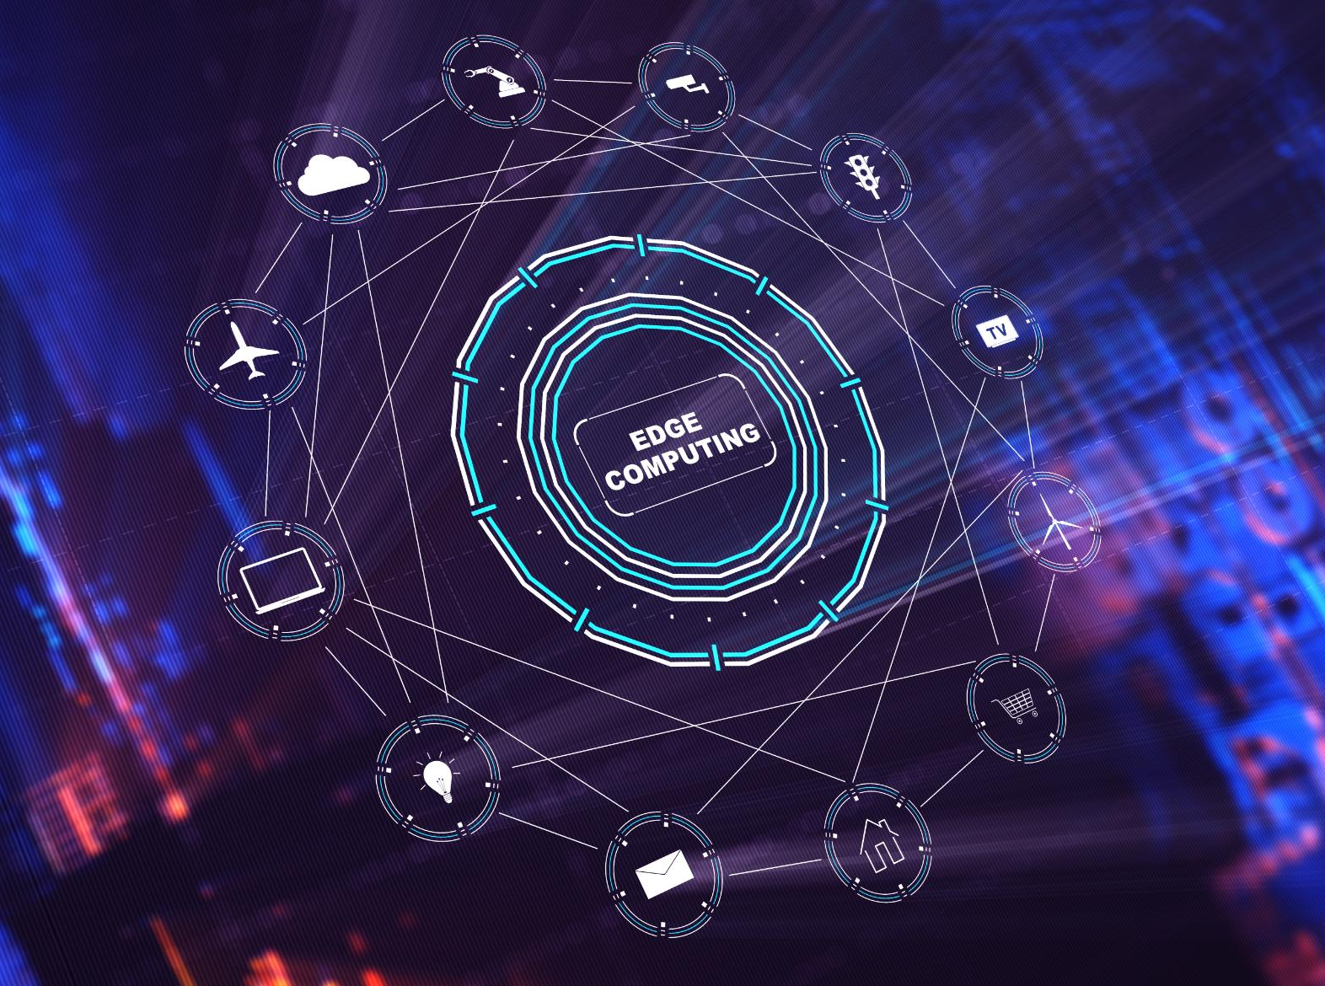
Common Data Sources
Transactional Systems
  Transactional systems are a common source of data for analytics, providing valuable insights into business operations and customer behavior.
IoT and Sensor Data
  IoT and sensor data are becoming increasingly popular for data analytics, providing valuable information about machine performance, environmental conditions, and consumer behavior.
Social Media Platforms
  Social media platforms are a rich source of data for understanding consumer behavior, sentiment analysis, and trend analysis.
Surveys and Polls
  Surveys and polls provide valuable insights into customer preferences, opinions, and attitudes, helping organizations make informed decisions.
Notes:
There are several common data sources, including transactional systems, IoT and sensor data, social media platforms, surveys and polls, and third-party datasets. Understanding these sources and their characteristics is crucial to successfully analyzing and managing data.

Slide 11

Data Capture Methods
APIs and Data Streams
  Application Programming Interfaces (APIs) and Data Streams are commonly used methods of capturing data. They offer real-time data access and are often used by businesses to stay up-to-date with changes in the market and customer behavior.
Web Scraping
  Web Scraping is a method of extracting data from websites and online sources. It is useful for gathering information on competitors, pricing, and industry trends.
Manual Data Entry vs. Automated Collection
  Manual Data Entry and Automated Collection are two ways in which data can be captured. While manual data entry is time-consuming and prone to errors, automated collection can be more efficient and accurate, provided that the right tools and processes are in place.
Notes:
Data can be captured using several methods, including APIs and data streams, web scraping, and manual data entry vs. automated collection. Each method has its own advantages and disadvantages, and choosing the right method depends on the specific needs of the organization.

Slide 12
Databases
Notes:
Databases are essential for managing and analyzing large volumes of data. In this section, we will explore the different types of databases, database management systems, and database operations.

Slide 13

What is a Database?
  A database is a structured collection of data that is organized in a way that allows for efficient storage, retrieval, and analysis. This helps in the efficient management of large volumes of data and ensuring data integrity.
Notes:
A database is a structured collection of data that is organized in a way that allows for efficient storage, retrieval, and analysis. Databases are essential for managing large volumes of data and ensuring data integrity.

Slide 14
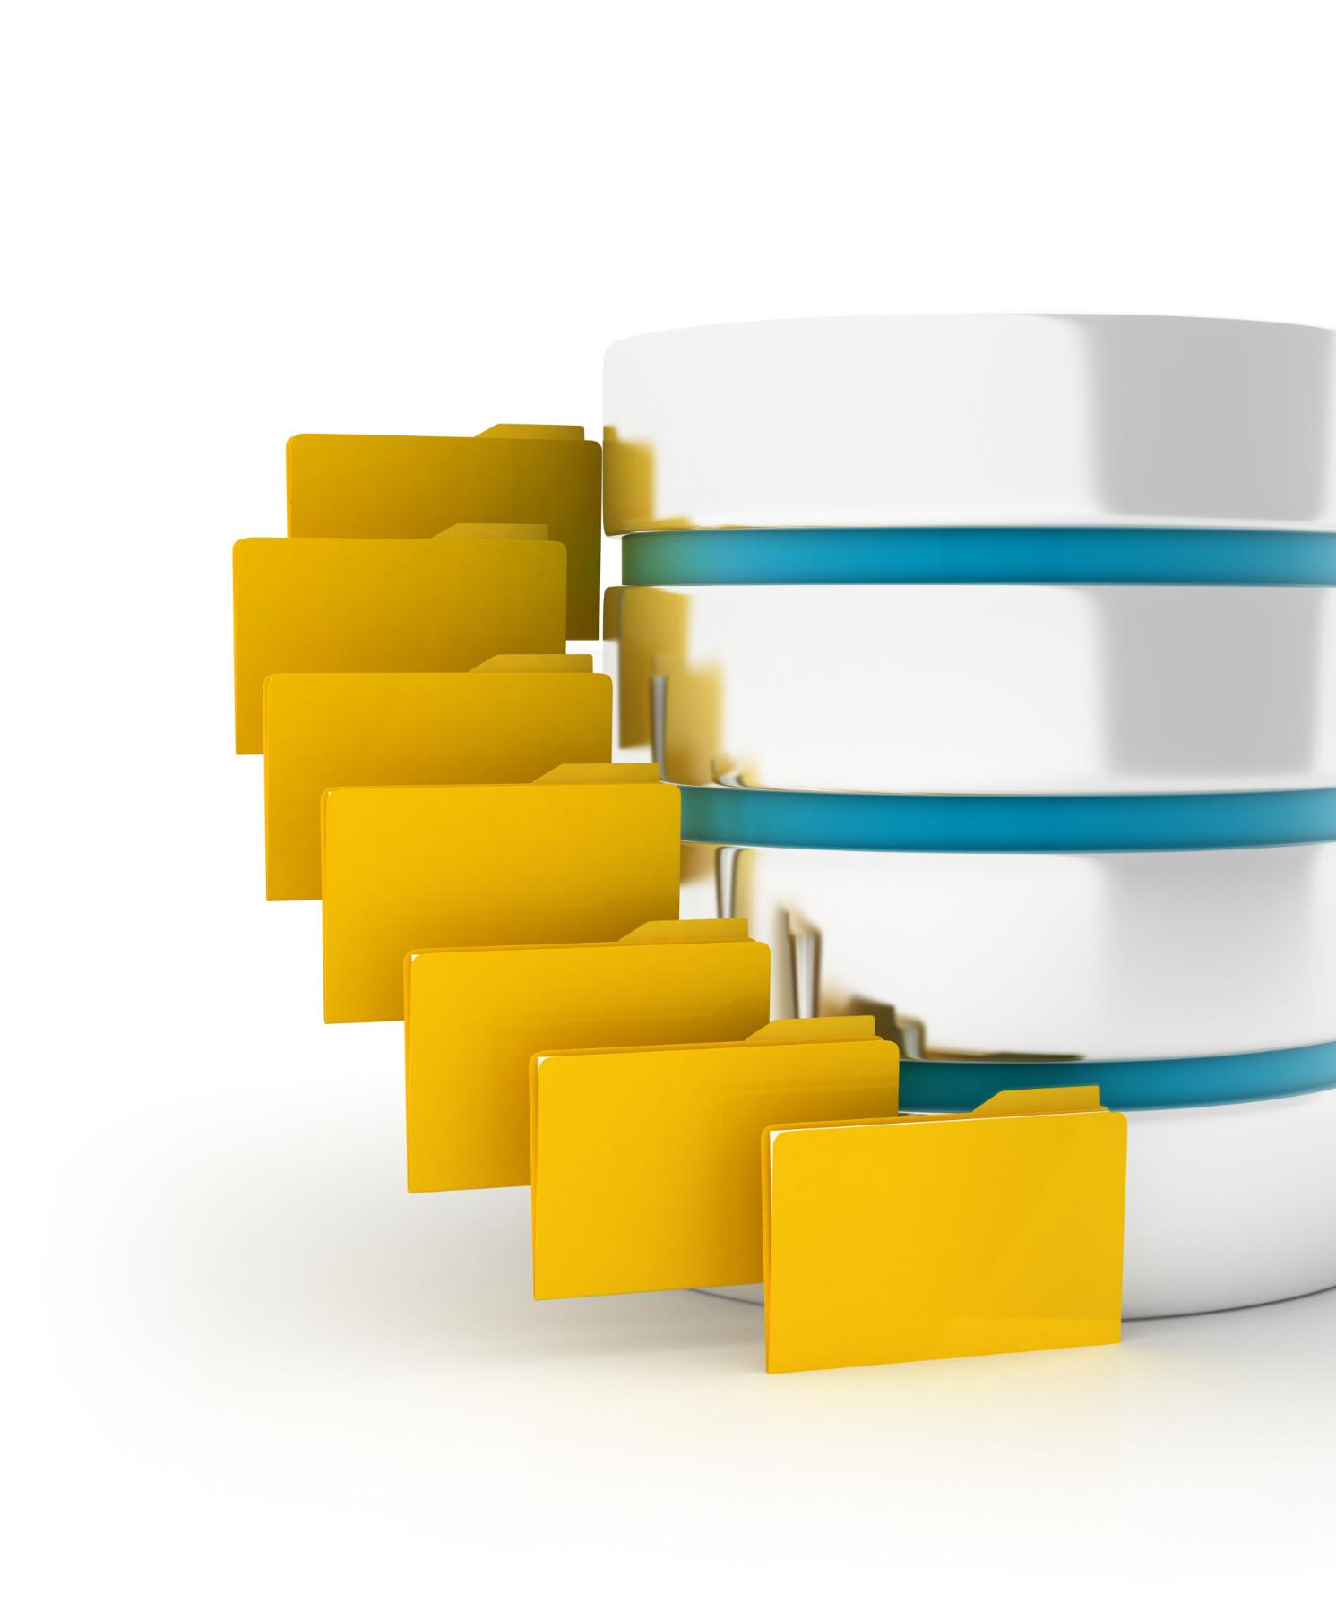
Types of Databases
Relational databases
  Relational databases are the most common type of database and store data in tables with rows and columns. They are widely used in businesses and organizations for their ease of use and reliability.
NoSQL databases
  NoSQL databases are non-relational databases that allow for flexible and scalable data storage. They are often used for big data and real-time applications.
Key-value stores
  Key-value stores are a type of NoSQL database that stores data as a collection of key-value pairs. They are often used for caching and session management.
Notes:
There are several types of databases, including relational databases, NoSQL databases, key-value stores, column-family stores, and document stores. Each type of database has its own unique advantages and disadvantages, and choosing the right type depends on the specific needs of the organization.

Slide 15

Database Management Systems
  A database management system (DBMS) is a software application that enables users to easily create, maintain, and access databases. It provides tools for managing the data and ensuring its integrity and security.
Notes:
A database management system (DBMS) is software that provides functions for creating, maintaining, and accessing databases. Popular DBMS solutions include MySQL, Oracle, and Microsoft SQL Server.

Slide 16

Database Operations
CRUD Operations
  CRUD operations are fundamental database operations that include creating, reading, updating, and deleting data. Understanding CRUD operations is essential for managing and manipulating data in databases.
Query Languages
  Query languages, such as SQL, are essential for querying and retrieving data from databases. Knowing query languages is essential for performing advanced data analysis.
Notes:
Database operations include create, read, update, and delete (CRUD) operations, as well as query languages, such as SQL. Understanding these operations is essential for effectively managing and analyzing data.

